Slide 1
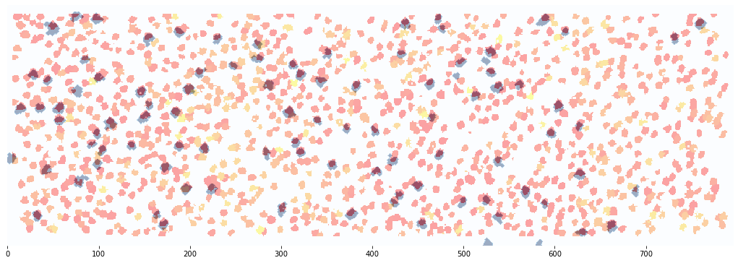
'''out = 0.0683 0.0000 -1.1100 -0.5500.
roll up 1 line, left 0.5 line (impossible w/o extrapolation)'''

Slide 2
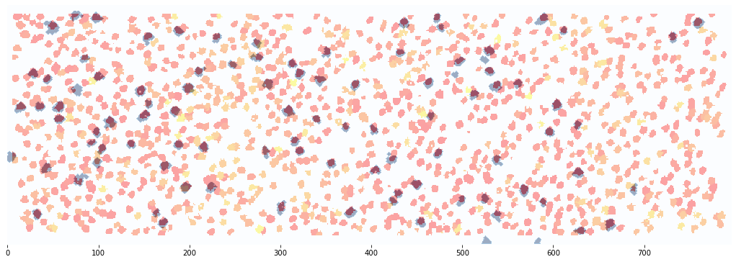
'''out = 0.0683 0.0000 -1.1100 -0.5500.
roll up 1 line, left 0.5 line (impossible w/o extrapolation)'''

Slide 3
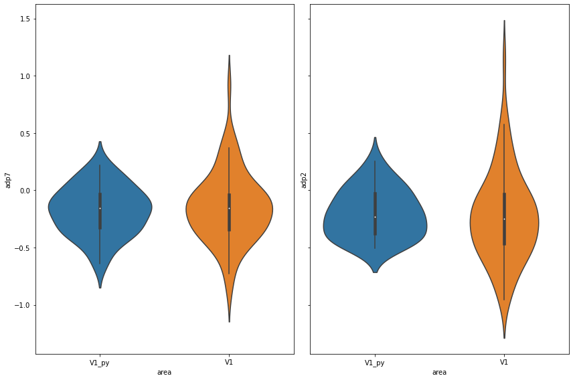

Slide 4
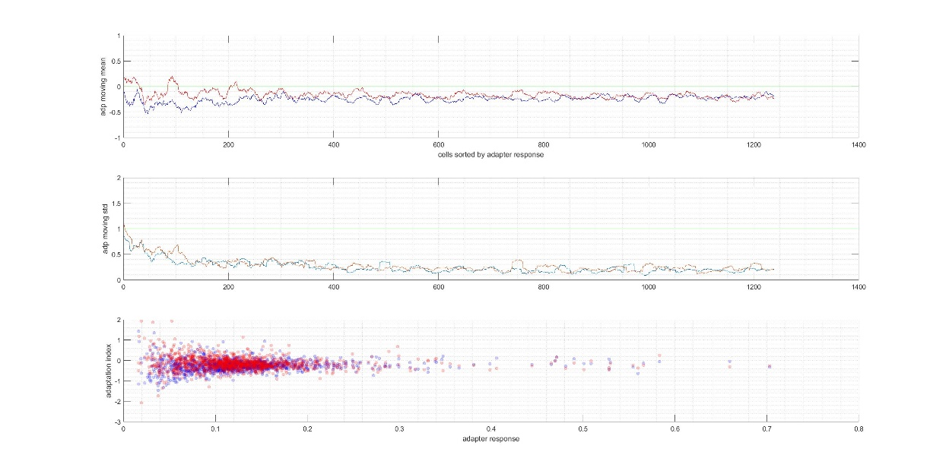
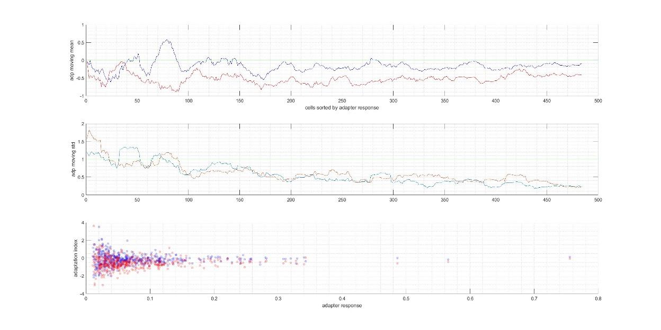

Slide 5
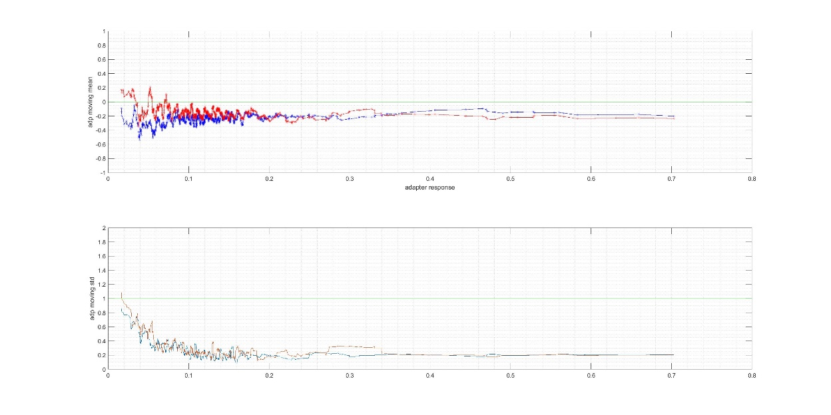
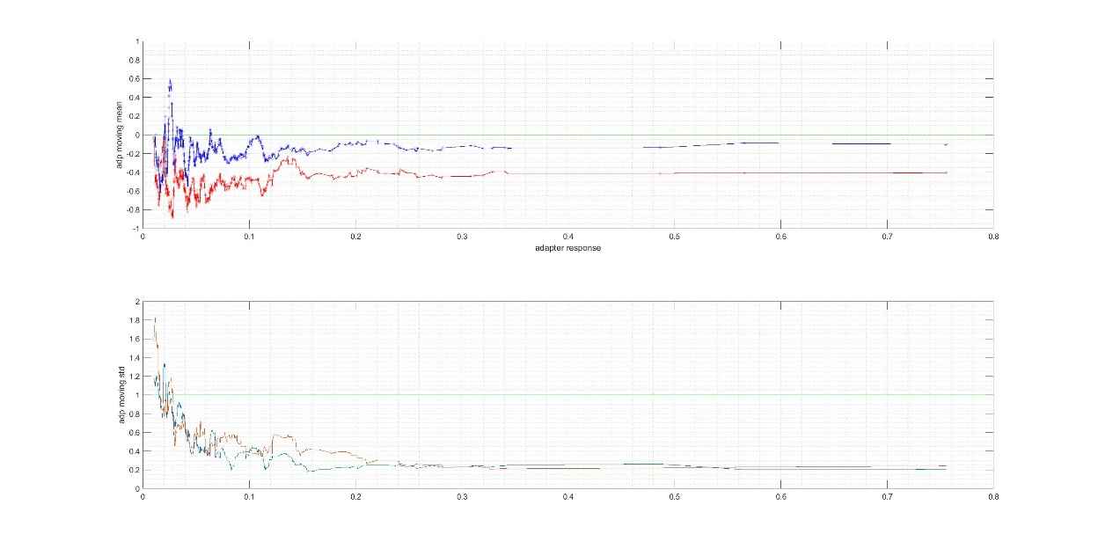

Slide 6
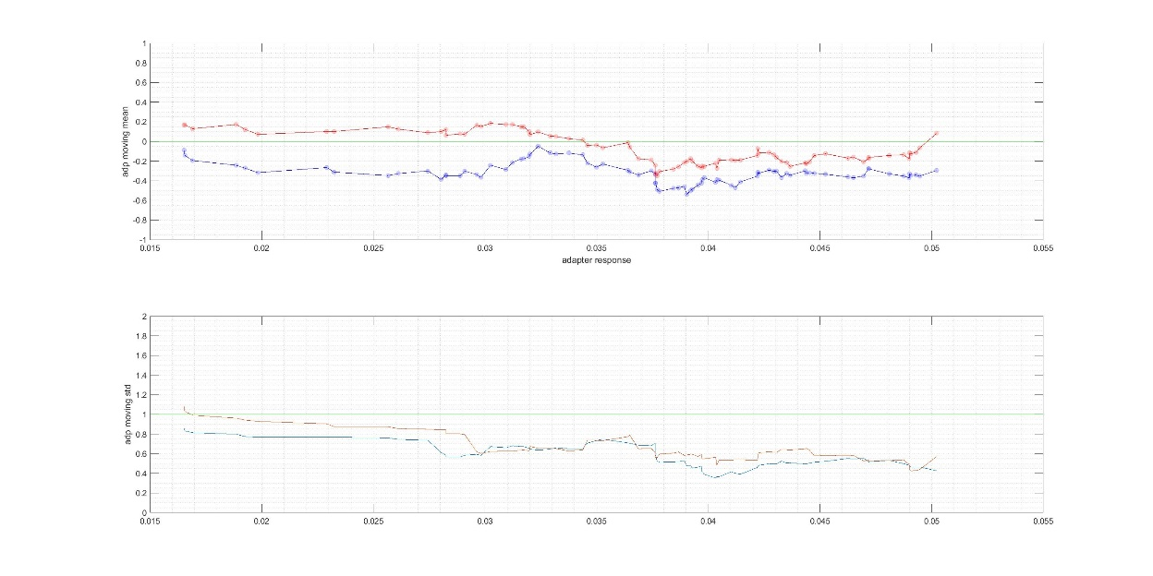
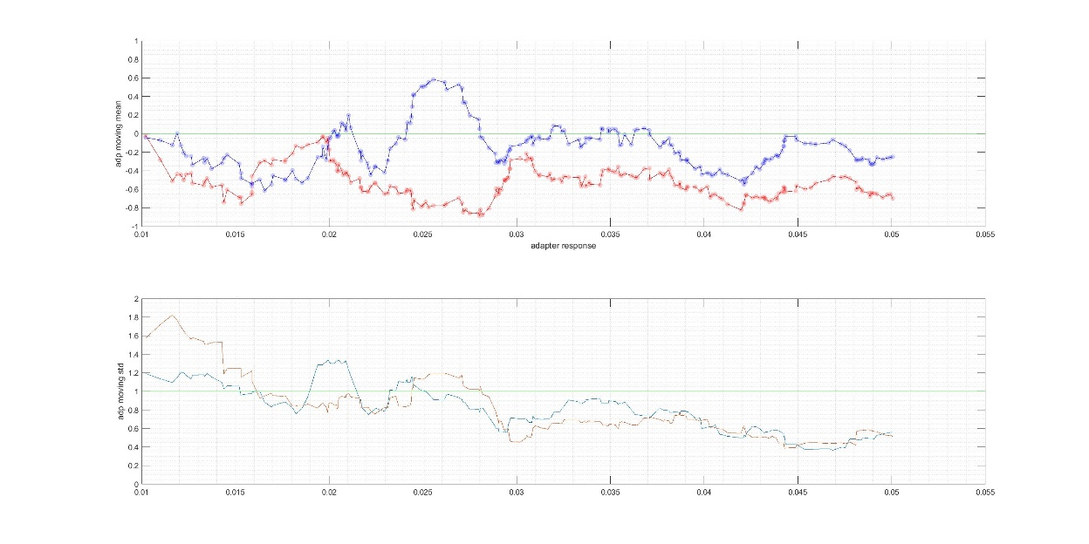
dfof_ad_cutoff = 0.3000 0.0516

Slide 7
